Slide 1
Gender and Women’s Studies
Intro to Data Science
...and why it matters to you

Slide 2
Why Statistics?
Notes:
Open it up to the audience and take responses!

Slide 3

Statistics can be misleading.

Slide 4
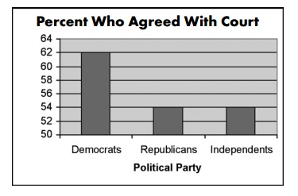
Always try to total up percentages and probabilities!

Slide 5
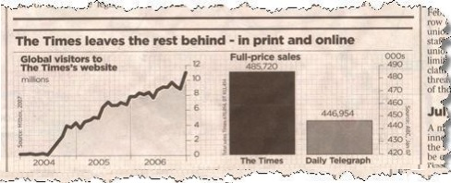
Look at where the scale begins!
Notes:
The Times is only beating its competition by about 10% but the graph makes it seem like its almost *double* as much.

Slide 6
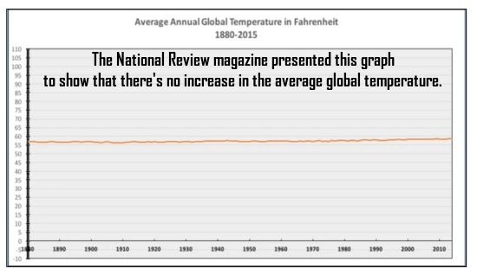

Slide 8
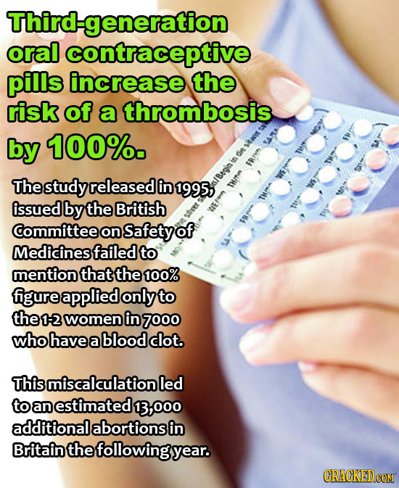
Watch out for the sample groups!

Slide 9
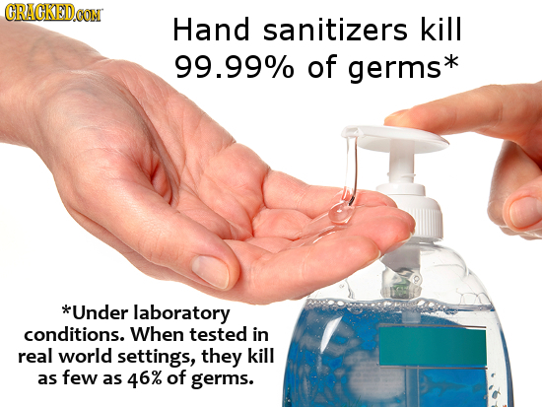
Read all data on the graphics!

Slide 10
Moral of the Story:
Educate Ourselves!

Slide 11
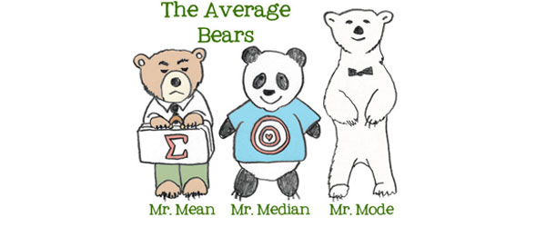
Measures of Center

Slide 12
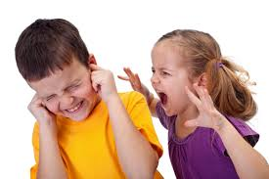

MEAN

Slide 13
Mean
The mean is a calculated "central" value of a set of numbers.
To find the mean just add up all the numbers, then divide by how many numbers there are.

Slide 14
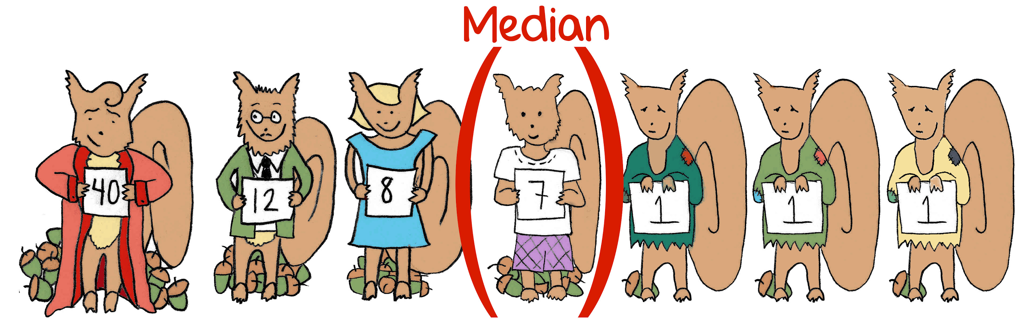
MEDIAN

Slide 15
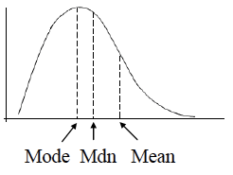
Median
The middle value in a range of arranged values.

Slide 16


MODE

Slide 17
Mode
The value that occurs most frequently in a given set of data.
13, 13, 13, 13, 14, 14, 16, 18, 21

Slide 18
When would it best to use each one?
Most highly paid category of people in Microsoft
GDP per capita in California
Household incomes, with some outliers
Talk to your neighbor!

Slide 19
Answers
MODE
Most highly paid category of people in Microsoft
MEAN
GDP per capita in California
MEDIAN
Household incomes, with some outliers

Slide 20
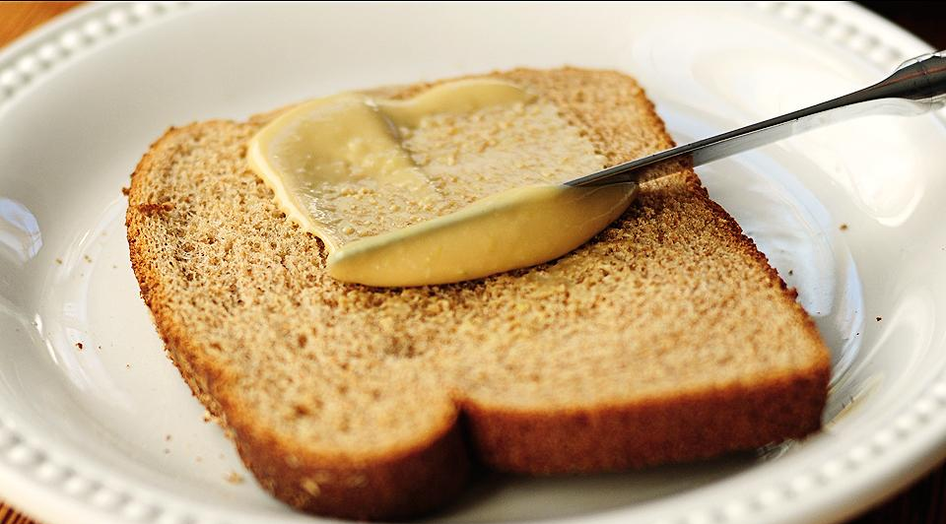
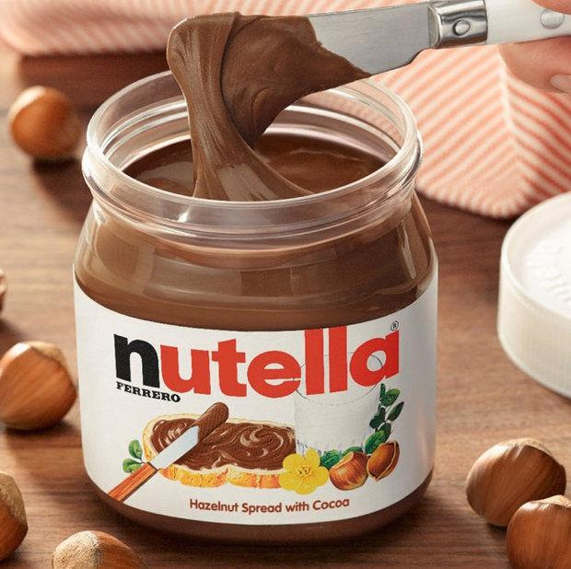
S P R E A D

Slide 21
Spread
Spread - how similar or varied the set of observed values are for a particular variable
How spread out is the data?
Measured with:
Range
Quartiles and Interquartile Range
Standard Deviation
Notes:
http://www.abs.gov.au/websitedbs/a3121120.nsf/home/statistical+language+-+measures+of+spread

Slide 22
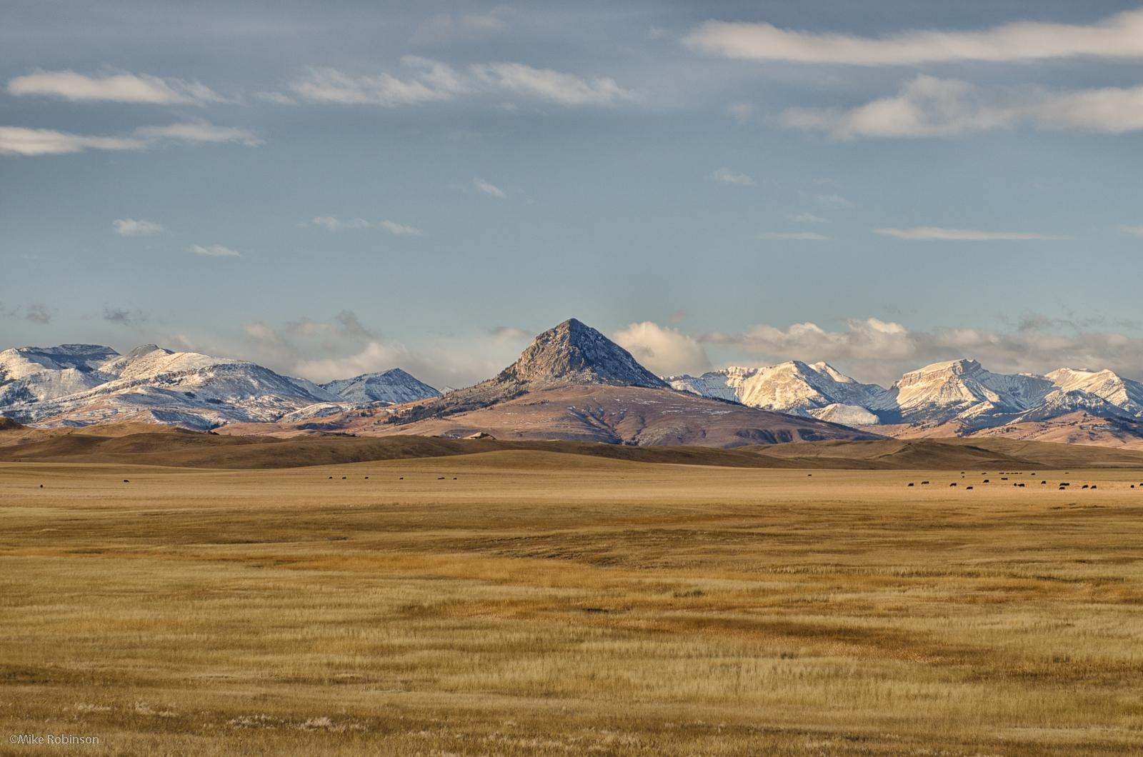
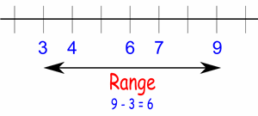
Range
Range = largest value - smallest value
Notes:
Affected by outliers

Slide 23
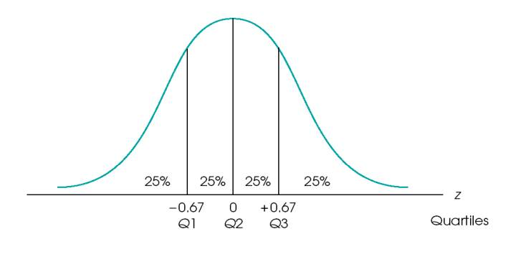
Quartiles
Splitting data into 4 parts (with 3 points)
Quartiles refer to the value between each quarter
Interquartile Range = IQR = Q3 - Q1
Notes:
Affected by outliers

Slide 24
Steps to Calculate:
Order numbers from lowest to highest.
Find median: that’s your Q2!
Find the median of the left-hand side: that’s your Q1!
Find the median of the right-hand side: that’s your Q3!
IQR = Q3 - Q1

Slide 25
Let’s Try It!
Hours of sleep last night:
5 | 7 | 4 | 8 | 8 | 9 | 7 | 11
Find the range.
Find Q1, Q2, Q3, and the IQR.

Slide 26
Let’s Try It!
5 | 7 | 4 | 8 | 8 | 9 | 7 | 11
Order numbers:
4 | 5 | 7 | 7 | 8 | 8 | 9 | 11

Slide 27
Let’s Try It!
4 | 5 | 7 | 7 | 8 | 8 | 9 | 11
Range = largest # - smallest #
= 11 - 4
= 7

Slide 28
Let’s Try It!
4 | 5 | 7 | 7 | 8 | 8 | 9 | 11
Find median.
4 | 5 | 7 | 7 | 8 | 8 | 9 | 11
( 7 + 8 ) / 2 = 15 / 2 = 7.5 = Q2

Slide 29
Let’s Try It!
4 | 5 | 7 | 7 | 8 | 8 | 9 | 11
4 | 5 | 7 | 7 | 8 | 8 | 9 | 11
Find median of left-hand side.
4 | 5 | 7 | 7
( 5 + 7 ) / 2 = 12 / 2 = 6 = Q1

Slide 30
Let’s Try It!
4 | 5 | 7 | 7 | 8 | 8 | 9 | 11
4 | 5 | 7 | 7 | 8 | 8 | 9 | 11
Find median of right-hand side.
8 | 8 | 9 | 11
( 8 + 9 ) / 2 = 17 / 2 = 8.5 = Q3

Slide 31

Let’s Try It!
Range = 7
Q1 = 6
Q2 = 7.5
Q3 = 8.5
IQR = Q3 - Q1 = 2.5
What does this mean?

Slide 32
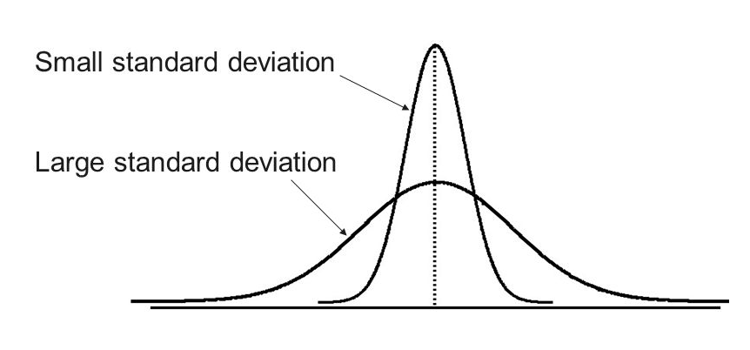
Standard Deviation
How close is the rest of the data to the mean?
Notes:
Affected by outliers

Slide 33
Outlier s

Slide 34
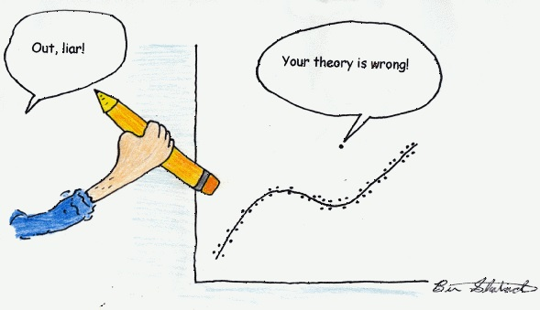
....or is it?

Slide 35
Outliers have drastic impacts!
Affect...
Mean: big outlier “pulls” mean to the right)
Range
Standard Deviation
Do not affect...
Median
Mode
IQR

Slide 36
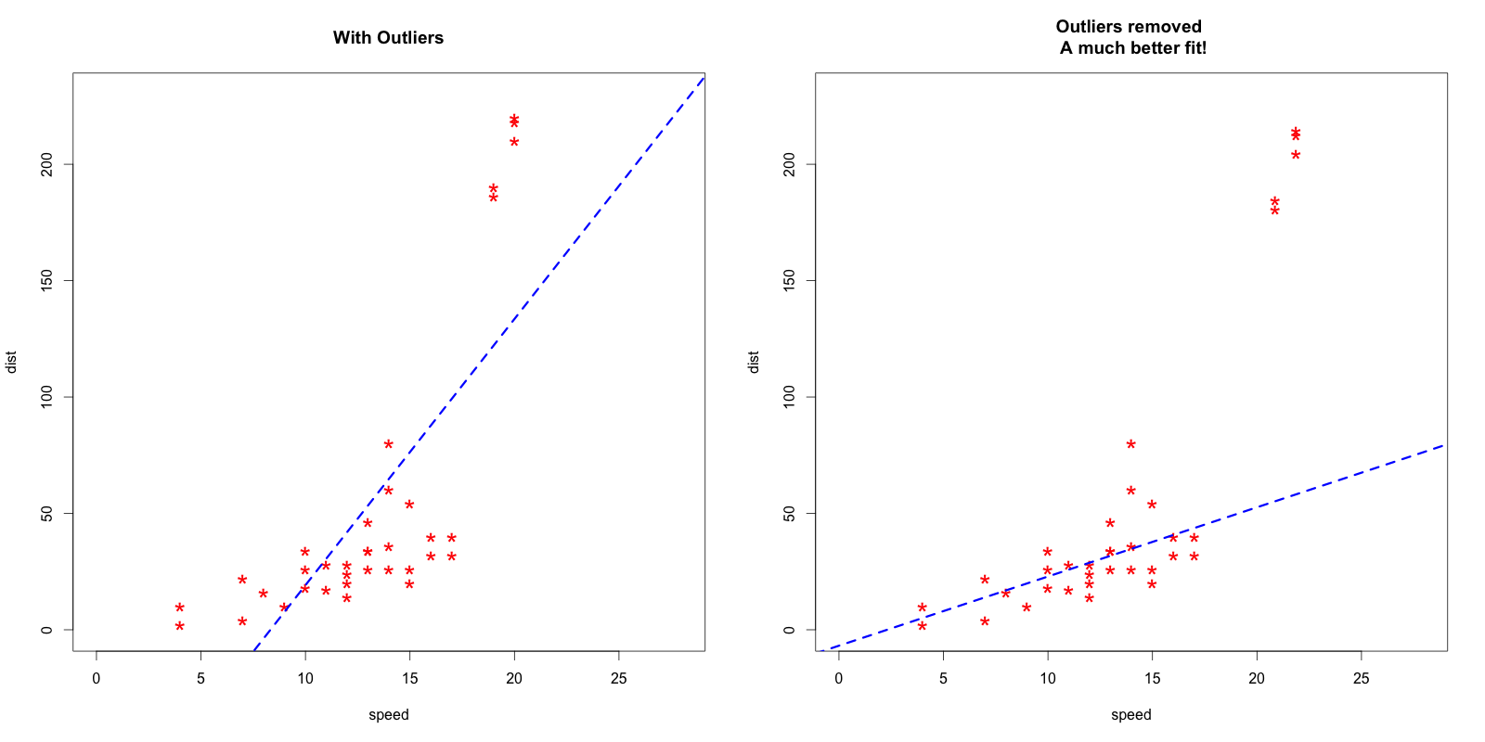
To view a trend, outliers can be hurtful...

Slide 37

...but to understand a phenomenon, they are essential.

Slide 38
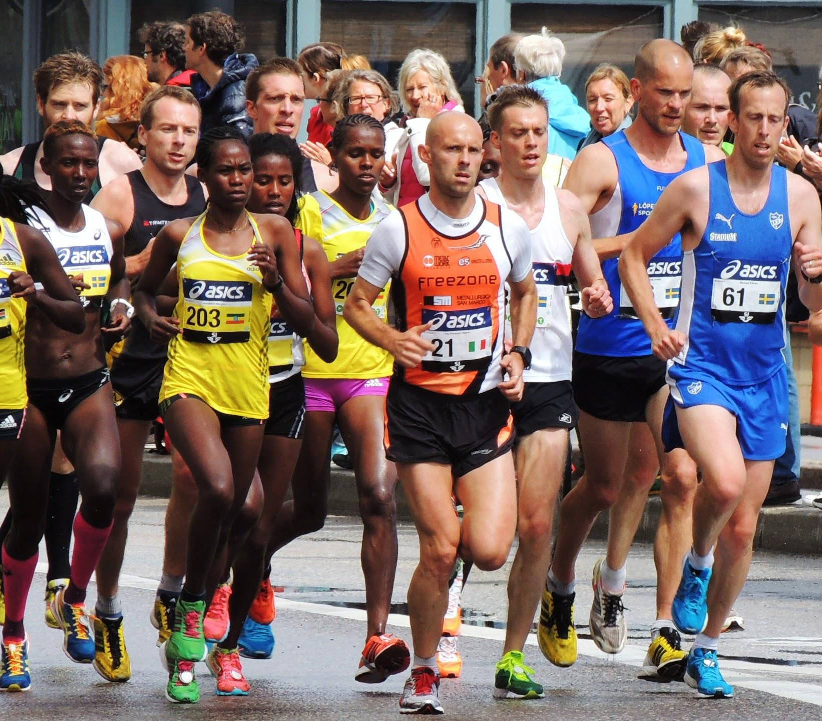
Measuring mile times:
One person gets a 5:12, while the average is 7:34.

Slide 39
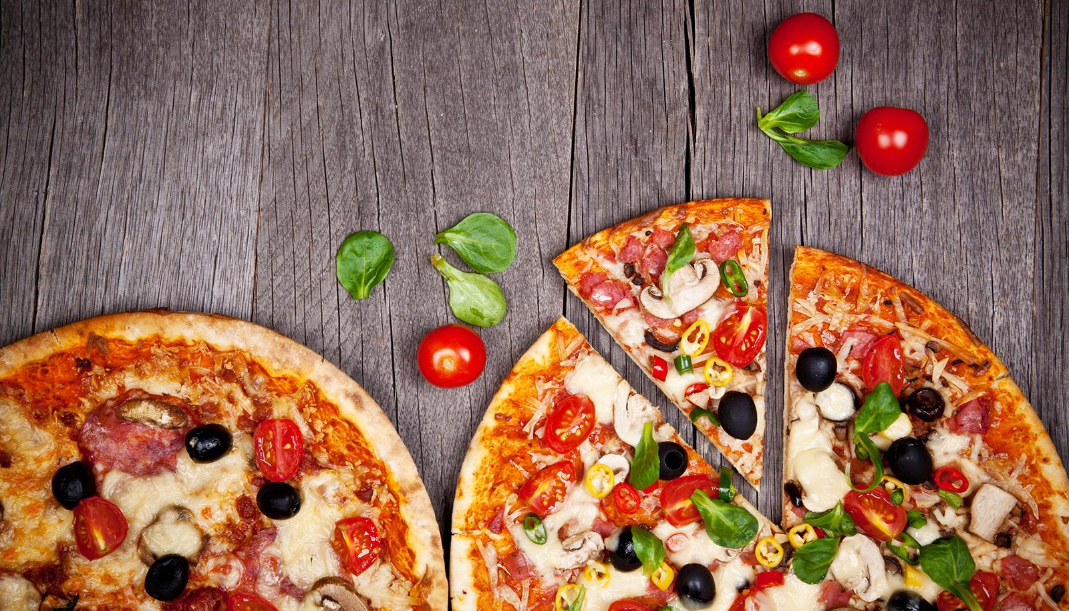
Pizza Delivery:
The Northeast coast of the USA tends to have higher average delivery time, especially in December.

Slide 40

Salary:
“In 2015, female full-time, year-round workers made only 80 cents for every dollar earned by men.” But the CEO of IBM, Ginni Rometty, makes much more than the average worker*.
*$35,000 vs. $1.6 million
Notes:
https://iwpr.org/issue/employment-education-economic-change/pay-equity-discrimination/

Slide 41
ASSOCIATION VS CAUSATION

Slide 42
ASSOCIATION
There exists a relationship between two or more variables.
Related variables!

Slide 43
CAUSATION
Changes in one variable directly caused changes in the other.
When one thing causes another to happen!

Slide 44
CONFOUNDING FACTOR
An underlying difference between the two groups.
It might confound you (confuse/surprise you) when you try to reach a conclusion.

Slide 45
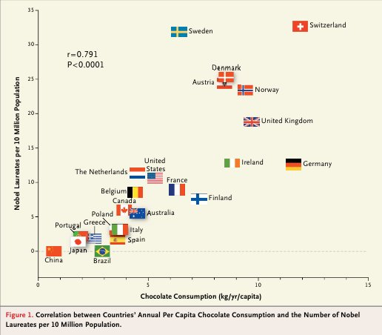

Slide 46
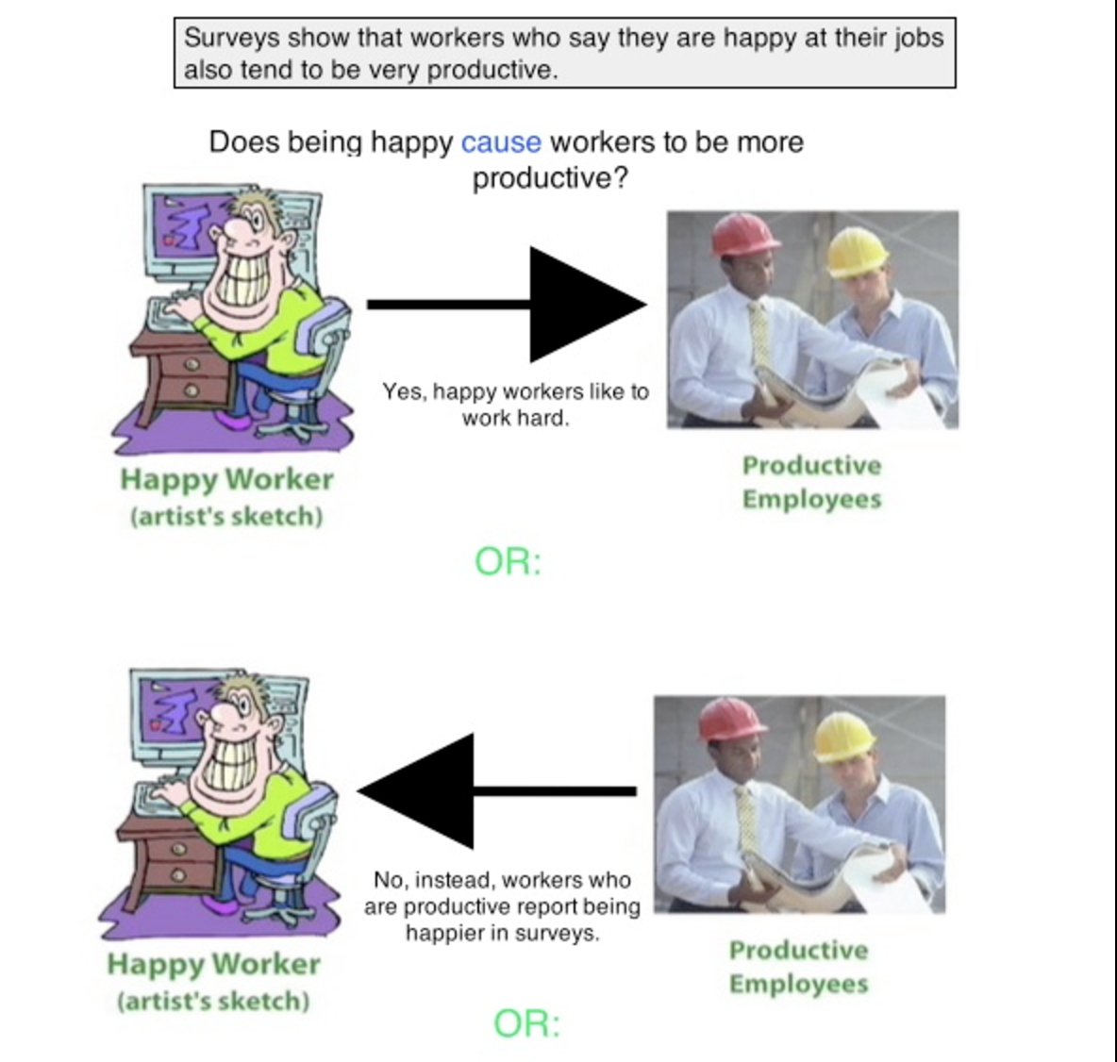

Slide 47
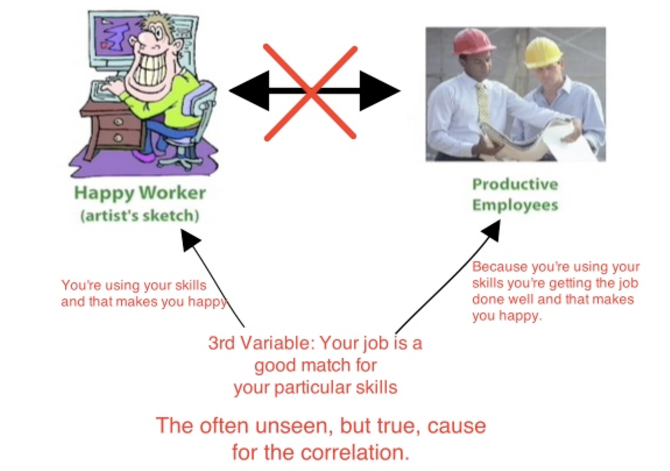

Slide 48
Let’s think!
Studies in the 1960’s showed that coffee drinkers had higher rates of lung cancer than those who did not drink coffee. Because of this, some people identified coffee as a cause of lung cancer.
Coffee and lung cancer

Slide 49


Slide 50
ANSWER
Smoking was a confounding factor here. In those days, coffee drinkers were also likely to have been smokers, and smoking does cause lung cancer. Coffee drinking was associated with lung cancer, but it did not cause the disease.

Slide 51
MEASURING SIGNIFICANCE

Slide 52
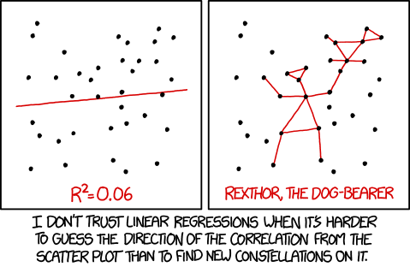

Slide 53
Hypotheses
Null hypothesis (H_{o}): there is no relationship between variables
Alternate hypothesis (H_{A}): there is a relationship between variables
Ex: Consider a new treatment for cancer that is 25% effective.
H_{o}: The treatment is less than 25% effective.
H_{A}: The treatment is effective more than 25% of the time.

Slide 54
P-value
Probability of observing current data or a data that is more extreme, assuming that the null hypothesis is true
Example:
Assume that the treatment is less than 25% effective.
When we perform an experiment, we find that the treatment is 30% effective.
P-value to find: probability that this number occurred, purely by chance

Slide 55
Making a conclusion
P-value: probability that result occurred by “random chance” (not because of a treatment)
If p-value < 5%, we reject the null hypothesis and accept the alternate hypothesis
If p-value > 5%, we fail to reject the null hypothesis
Example: Say that the p-value was 3%.
Reject null hypothesis and accept alternate hypothesis that the treatment is more effective than 25%.

Slide 56
Confidence Intervals
Used to describe uncertainty associated with sampling method
Example: 90% CI states that the mean is between 10 and 20.
NO: 90% chance that the mean is between 10 and 20
YES: If we repeatedly take many intervals, 90% of those intervals will include the “correct” mean value.

Slide 57
Extended Example
GWS 10 has a course average GPA of 3.52
Spring 2016 had average GPA of 3.76

Slide 58
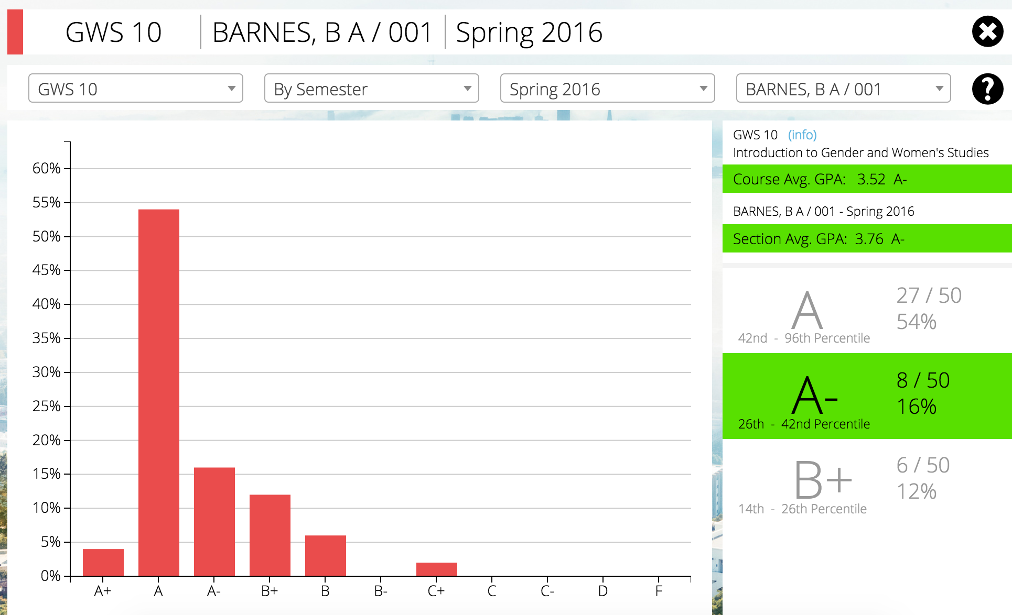
Extended Example

Slide 59
Extended Example
GWS 10 has a course average GPA of 3.52
Spring 2016 had average GPA of 3.76
Question: Was the class easier during this semester than it was compared to other years?
Step 1: Null/Alternate Hypotheses:
H_{o}:
The class was just as hard in Spring 2016 as it was in every other semester.
H_{A}:
The class was easier in Spring 2016 than it was in other semesters.

Slide 60
Extended Example
Step 2: Finding p-value
We did this step for you.
P-value of 8%
Step 3: Make conclusion
With a p-value of 8%, we…
Reject the null hypothesis and accept the alternate hypothesis
Fail to reject the null hypothesis

Slide 61
Regression

Slide 63
What is regression?
A statistical process for estimating the relationships among variables

Slide 64
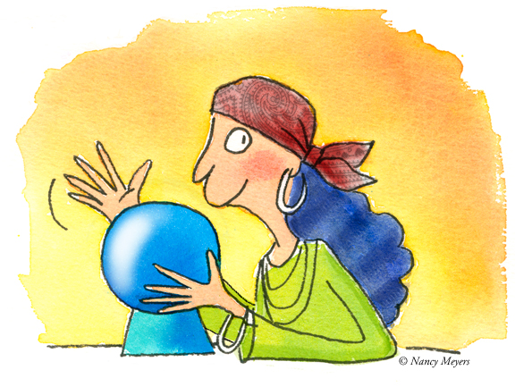
Why regression?
Find trends in your data
Use those trends to predict values for other data

Slide 65
Conclusion
What exactly did we learn today?

Slide 66
We learned that...
There are many different ways to look at stats
Stats apply to all fields, including GWS
Numbers do not lie, but watch out for the way they’re represented!
Numbers support your research!

Slide 67

Go Stats!!!

Slide 68
Questions?

Slide 69
Bibliography
http://www.cracked.com/photoplasty_2052_19-ways-you-can-make-statistics-say-whatever-you-want/
http://www.abs.gov.au/websitedbs/a3121120.nsf/home/statistical+language+-+measures+of+spread
https://medium.com/@dhexonian/why-are-outliers-useful-495cb9a5cf9b#.4xxfrul7r

